Slide 1

NAUČILI
SMO
Aa
Uu
Ee
Oo
Ii

Slide 2

A
a
VELIKO TISKANO
MALO TISKANO

Slide 3
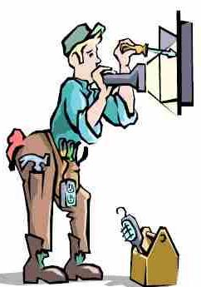
E
e
VELIKO TISKANO
MALO TISKANO

Slide 4
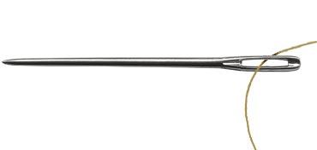
I
i
VELIKO TISKANO
MALO TISKANO

Slide 5

O
o
VELIKO TISKANO
MALO TISKANO

Slide 6

U
u
VELIKO TISKANO
MALO TISKANO

Slide 7
GLAS
IZGOVARAMO

Slide 8
IZGOVARAMO
GLASOVE
U
O
A
a
o
E
e
u
i
I

Slide 9
SLOVO
PIŠEMO

Slide 10
SLOVO
PIŠEMO
_____________________________________________________________________________________________________________________________________________________________________
_______________________________________________________
A
E
I
a
e
i
_____________________________________________________________________________________________________________________________________________________________________
_______________________________________________________
O
U
o
u

Slide 11
Č I T A M

Slide 12

A
u
A
u
A u

Slide 13

I
o
I
o
Io

Slide 14
A
E
i
o
a
u
u
i
O
I
i
u
u
a
u
a

Slide 16
Prezentaciju priredila
Antoneta Vilić
OŠ-FF-RI

